Slide 1
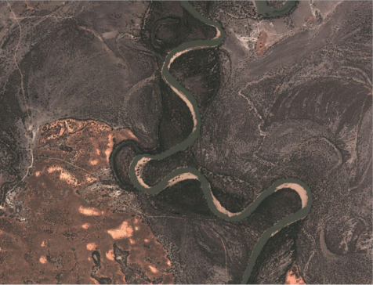

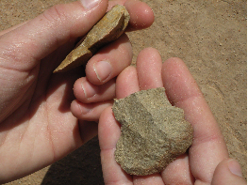
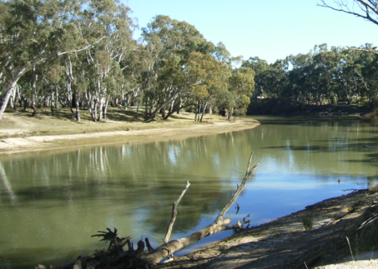
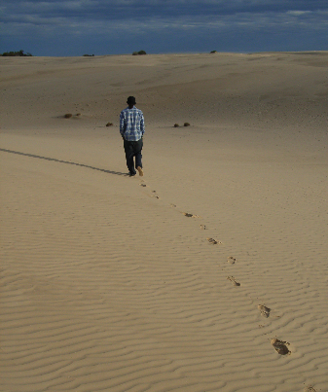
AQUA Biennial Conference
29th June to 4th July 2014
Grand Hotel, Mildura

Slide 2

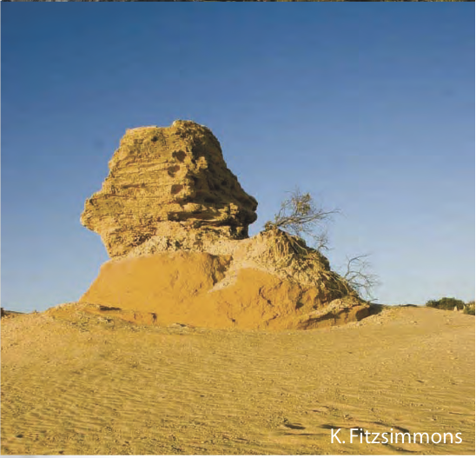
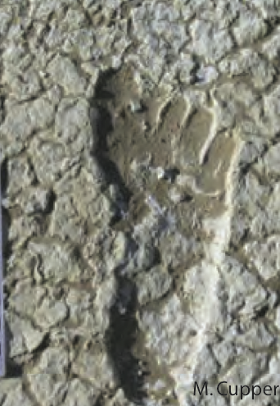
AQUA Mildura, 2014
We invite you to join us in celebrating the 30th anniversary of AQUA by coming back to where it all began. The Grand Hotel in Mildura hosted the first conference of the new association back in 1985 and we are honoured to have a good number of the original participants with us.
We will journey to the heartland of the Quaternary in Australia – the Willandra Lakes. The region that defined our unique geormorphology and crystallised the antiquity and significance of our first people. We will revisit old sites and learn of recent advances.
To pave the way forward, we encourage all people with an interest in the Quaternary to attend, particularly those of related fields, such as archaeology and environmental management.

Slide 3
Highlights
Our regular friendly atmosphere and top notch Quaternary science
Public lecture by Jim Bowler and friends
Conference dinner aboard PS Mundoo
Friday field trip to Willandra Lakes with
Beer o’clock sessions - loose tongue discussions and debates on:
The influence of people on Quaternary events
Importance of paleo-research for the IPCC
Management of the Murray Darling Basin from a deep time perspective

Slide 4
Proposed Program
Date | Day | Evening
27th – 28th June | Pre-conference Fieldtrips
29th June |  | Icebreaker
30th June | Scientific Sessions | Public Lecture
1st July | Scientific Sessions | Conference Dinner
2nd July | Scientific Sessions Murray Wetlands Tour | Brewery Tour
3rd July | Scientific Sessions | Trivia Night
4th July | Fieldtrip – Mungo “Lite”
5th July | Fieldtrip – Mungo for keeps

Slide 5
Proposed Sessions
Prehistoric Human Impact in Australia
New research in Willandra
Old sites revisited
Role of the Oceans and Ice
Lakes, Dunes, Dust and Soils
Lessons from rivers
The role of the Quaternary to inform management
SHAPE
CELL50K– interhemispheric comparsions
Open session

Slide 6
Field Trips
Pre-Conference:
Murray Cliffs and Palaeochannels 27th-28th June $250. From Mildura-Mildura (Hope)
Palaeochannels, dunes and floodplains. Sydney-Mildura (Hesse and White)
‘Mid’-Conference:
Murray wetlands afternoon 2nd July (Reeves)
Post Conference:
Lake Mungo – “Lite”. Friday 4th July.
Lake Mungo for keeps. Saturday 5th July.
Keep an eye on the AQUA website for further details as they emerge. Possible additions include a tour of the NW Victorian salt lakes (from Melbourne) and a trip from Adelaide.

Slide 7
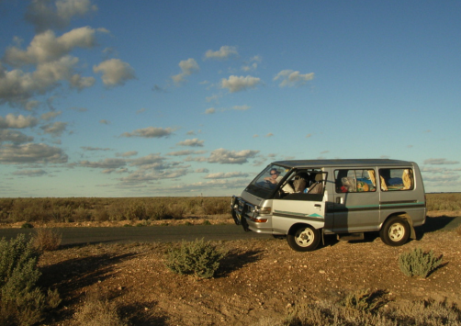
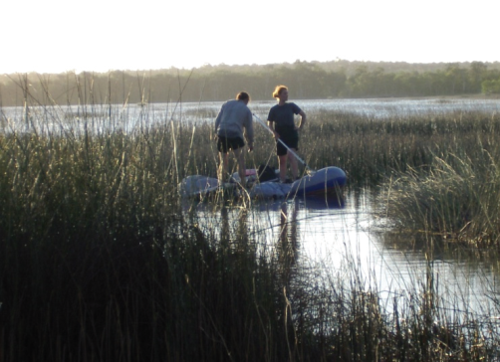
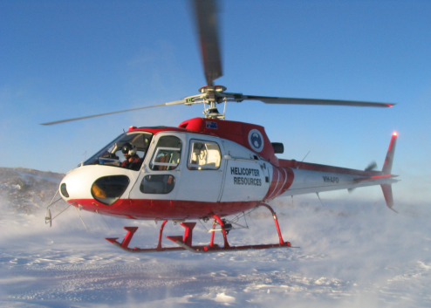
Getting there and back again
The pre and post conference field trips will get you to or from the venue, and are highly recommended if you have time.
The local tourist information service has a handy list of travel options at http://www.visitmildura.com.au/getting-to-the-region.html
Driving will take you 4 hours from Adelaide, 6 hours from Melbourne, 8 hours from Canberra and 11 hours from Sydney
Regular flights operate from Melbourne through Rex, Qantas or Virgin. Rex also services Sydney and Adelaide
Trains and buses are a reasonable proposition from Adelaide (Greyhound, Busesrus, 5 hours) and via Melbourne via V-line (8 hours). The masochistics might also like the journey from Sydney and Canberra (Greyhound, 16+ hours)

Slide 8
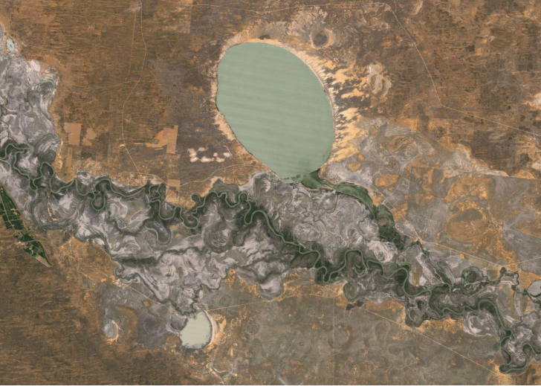
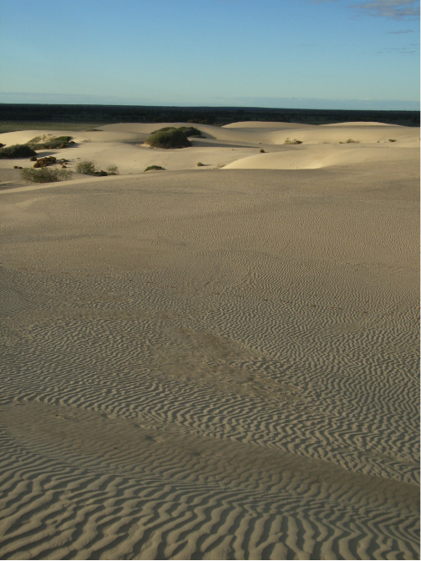
Registration and Abstracts
Submit abstracts to secretary@aqua.org.au by 17th of March, 2014. We will open abstract submission in January.
Proposed registration fees:
Full: $300 members ($375 non-members)
Student: $200 members ($250 non-members)
Registration includes:
icebreaker, BBQ & trivia night, lunch, morning and afternoon tea for 4 days, mid conference field trip to Murray wetlands on the Wednesday
Go to www.aqua.org.au for registration
Student travel awards up to $500 available for AQUA members, funded by AINSE and AQUA.

Slide 9
Accomodation
Conference Venue
We encourage you to support the Quality Hotel Mildura Grand, as they are providing the venue to us free of charge. A range of room styles are available.
http://www.qualityhotelmilduragrand.com.au/
Other options include:
Quest Apartments http://www.questapartments.com.au/Accommodation/420/Australia/Victoria_Regional/Quest_Mildura/Welcome.aspx
Range of big chain hotel/motels – Best Western, Comfort Inn, City Colonial ($80 – 150 pn)
Stopover Guesthouse – Dorm accom, max 6 per room, kitchen, secure $30 pppn (total 30)
Four caravan parks within walking distance

